Slide 1
DETERMINATION OF OPTIMUM CONTENT OF RAP IN WMA WITH ZYCOTHERM AS ADDITIVE
GUIDED BY:
PROF. SONALI SNEHAJAN
ASSISTANT PROFESSOR
DEPT. OF CIVIL ENGINEERING
GECBH
SUBMITTED BY:
DEVU M NAIR (64)
FINNY CHRIPS (60)
MIDHUN S M (35)
SHARON C BENNY (48)
S8 CE, GECBH

Slide 2
INTRODUCTION
HOT MIX ASPHALT
WARM MIX ASPHALT
RECLAIMED ASPHALT PAVEMENT
Production temperature: about 160ºC
Widely used everywhere.
High energy consumption and highly polluting.
Production temperature: about 140ºC
Started to be used in European countries and the U.S. from late 90s
Reduced energy consumption and more environmental friendly.
Recently being incorporated into WMA.
Sustainable and economic.

Slide 3
SCOPE AND OBJECTIVE
To study the shift in optimum binder content due to the addition of Zycotherm.
To do the volumetric analysis of Warm Mix Asphalt incorporated with different quantities of Reclaimed Asphalt Pavement (RAP).
To find the optimum quantity of RAP that can be incorporated with WMA.
To analyse the cost benefit of WMA to HMA

Slide 4
LITERATURE REVIEW
M. Guo et al. (2020)
H. Jahanbakhsh et al. (2019)
To propose recycling asphalt mixtures containing high percentages of RAP
The cost of the materials used in the study was analysed
M. J. Ayazi et al. (2017)
Mechanism of Zycotherm in WMA
The effects of various WMA additives on WMA- RAP technology
Found that the lower mixing temperature might affect the compaction process.
Chemical additives could perform better

Slide 5
1. MATERIAL PREPARATION
METHODOLOGY
VG 30 + WMA additive (Zycotherm)
Obtain RAP
Virgin binder
VG 30
Virgin Aggregates
Determine RAP properties
1.Binder content
2. Grading on Extracted aggregates
3. Specific Gravity
Determine binder Properties
1. Viscosity tests
2.Specific Gravity
3. Penetration
Determine Aggregate properties
1. Sieve analysis
2. Flakiness Index
3.Specific Gravity
4. Impact test

Slide 6
2. MIX DESIGN
Marshall method of mix design on controlled WMA mix at 4.5%,5%,5.5%,6% and 6.5% binder content
Marshall Mix Design of RAP integrated WMA mixes at 3 different binder contents
(OBC,OBC+0.5%,OBC-0.5%, OBC-1%)
WMA + 20% RAP
WMA+40% RAP
WMA+60% RAP
WMA+80% RAP

Slide 7
3. MIXTURE PERFORMANCE TESTS
Analysis of the results and determine the optimum RAP content in WMA using Zycotherm
Volumetric analysis on Optimum RAP modified WMA mixes

Slide 8
TESTS ON MATERIAL PROPERTIES
AGGREGATES
Sieve analysis
From IS 2386 ( Part 4) - 1963 – on the aggregates procured, sieve analysis was conducted – checked whether gradation matches with BC gradation fixed according to MoRTH (clause 507.2.5 page no: 189)
SIEVE SIZE | PERCENTAGE FINER (%) | STANDARD VALUES (%)-(MS-2)
9.5 mm | 75.11 | 70-88
4.75 mm | 54.98 | 53-71
2.36 mm | 45.31 | 42-58
1.18 mm | 34.86 | 34-48
600 µ | 28.43 | 26-38
300 µ | 20.67 | 18-28
150 µ | 14.99 | 12-20
75 µ | 7.89 | 4-10

Slide 9
CONTINUED..
Properties of Virgin aggregates
Sl. No | Test Conducted | Test Results | Requirements (As Per Is 2386 (Part 4) – 1963
1) | Flakiness Index Test | 18.53% | 25%
2) | Impact Test | 26.32% | 30%
3) | Specific Gravity Test | 12mm- 2.67 6mm- 2.74 M sand- 2.67 Dust- 2.7 | 2.5-3 2.5-3 2.5-3 2.5-3

Slide 10
CONTINUED..
BITUMEN
Mixed bitumen with Zycotherm
Zycotherm was taken about 0.125% of the bitumen and was mixed with the bitumen.
Properties of Bitumen
Sl. No | Test Conducted | Test Result | Requirements | Specifications
1) | Penetration Test | 54mm | >45mm | IS 73:2013
2) | Specific Gravity | 1.04 | Nil | Nil
3) | Viscosity test | 575.68 cSt | Min. 350 cSt | IS 1206 (Part 3)

Slide 11
CONTINUED..
11

Slide 12
RECLAIMED ASPHALT PAVEMENT (RAP)
Properties of RAP
Sieve Analysis
The binder content of the RAP using bitumen extractor was found to be 4.46%.
The specific gravity of the RAP was found to be 2.465
SIEVE SIZE | PERCENTAGE FINER (%) | STANDARD VALUES (%) – BC GRADATION (MS-2)
9.5 mm | 85.43 | 70-88
4.75 mm | 61.54 | 53-71
2.36 mm | 42.49 | 42-58
1.18 mm | 34.80 | 34-48
600 µ | 27.01 | 26-38
300 µ | 19.83 | 18-28
150 µ | 12.43 | 12-20
75 µ | 6.57 | 04-10

Slide 13
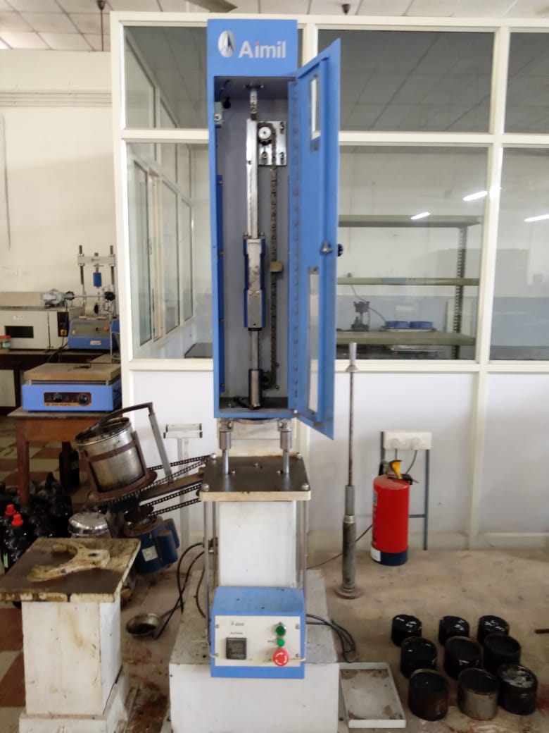
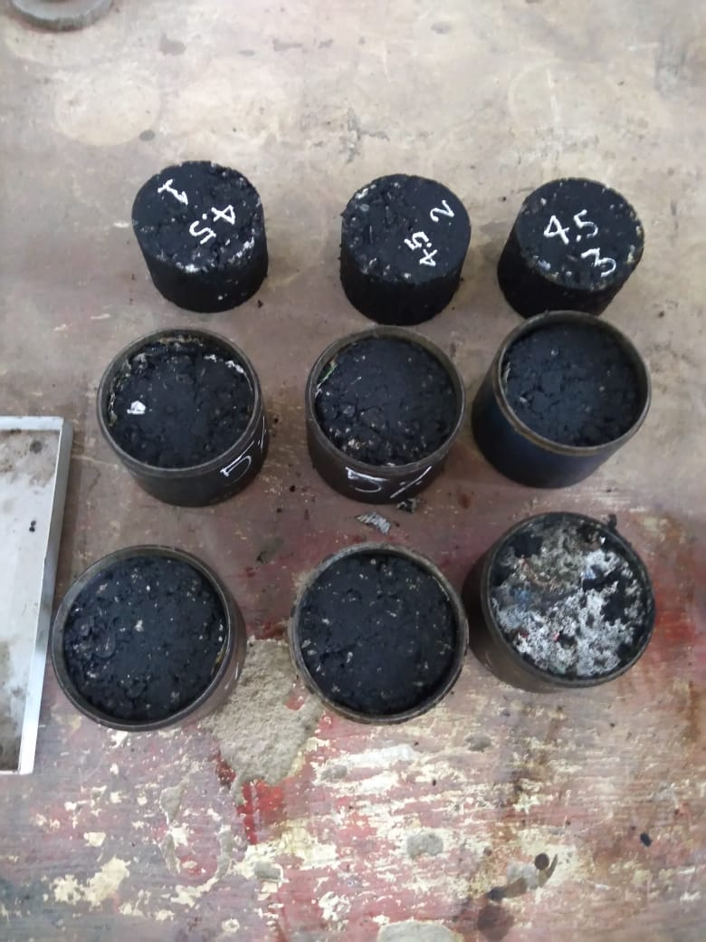
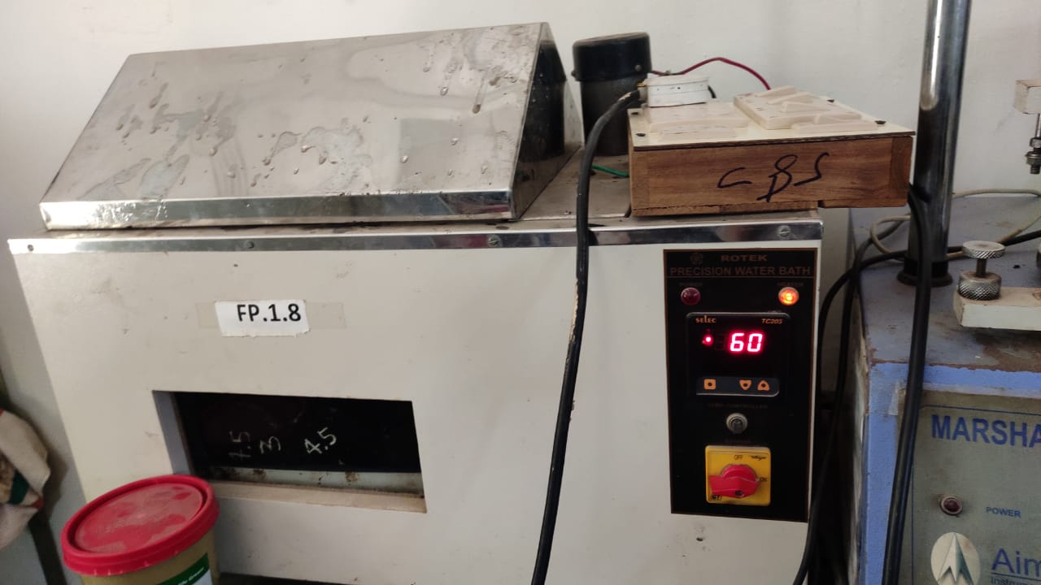
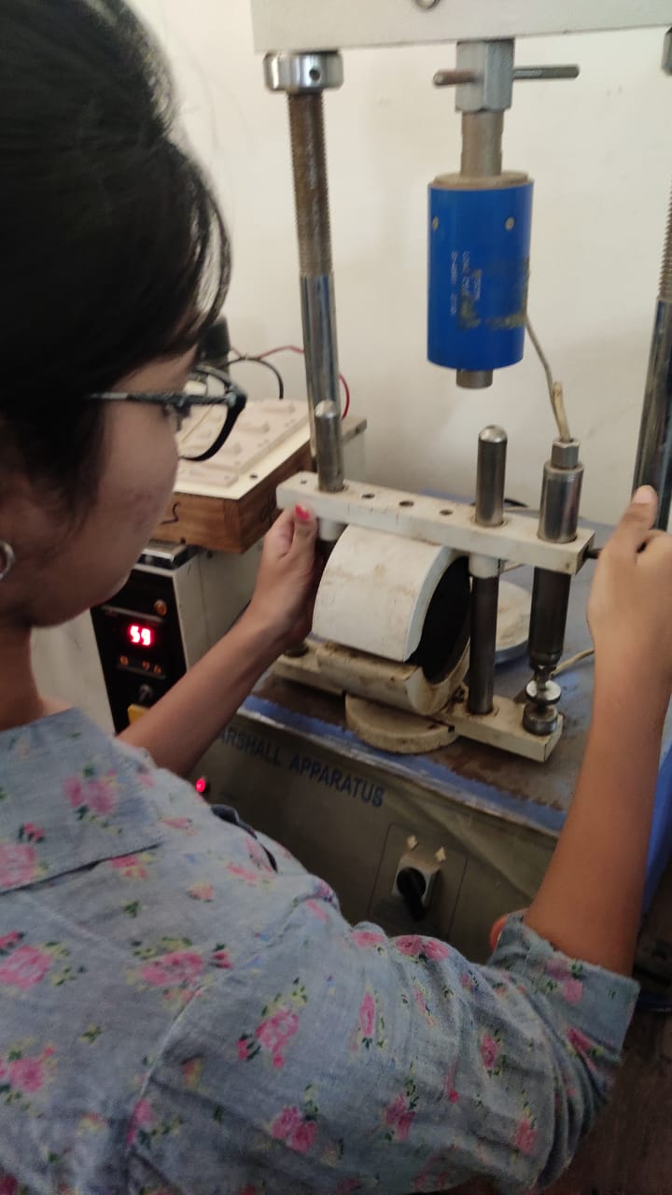
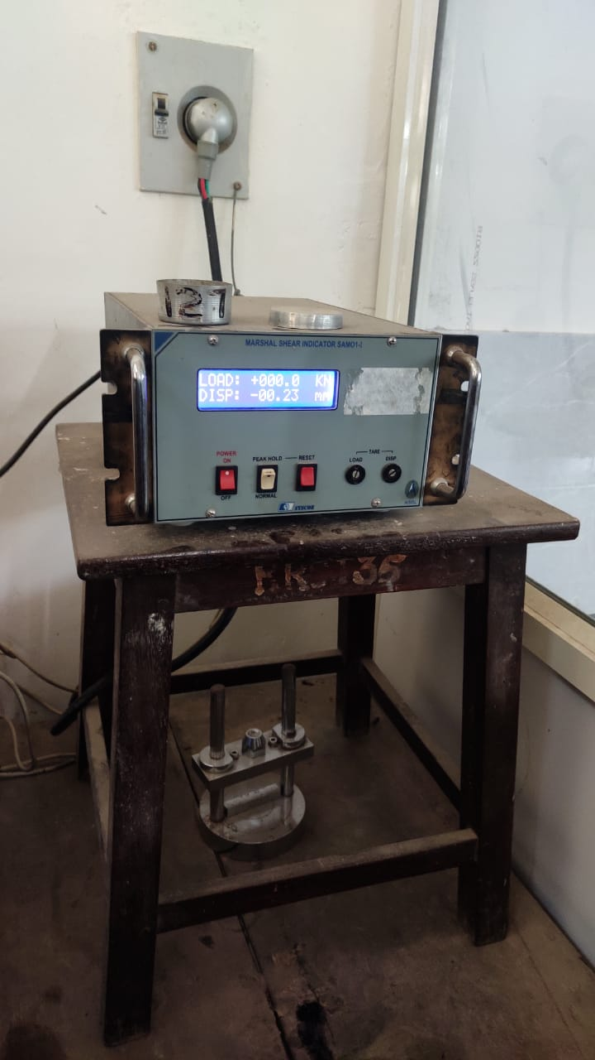
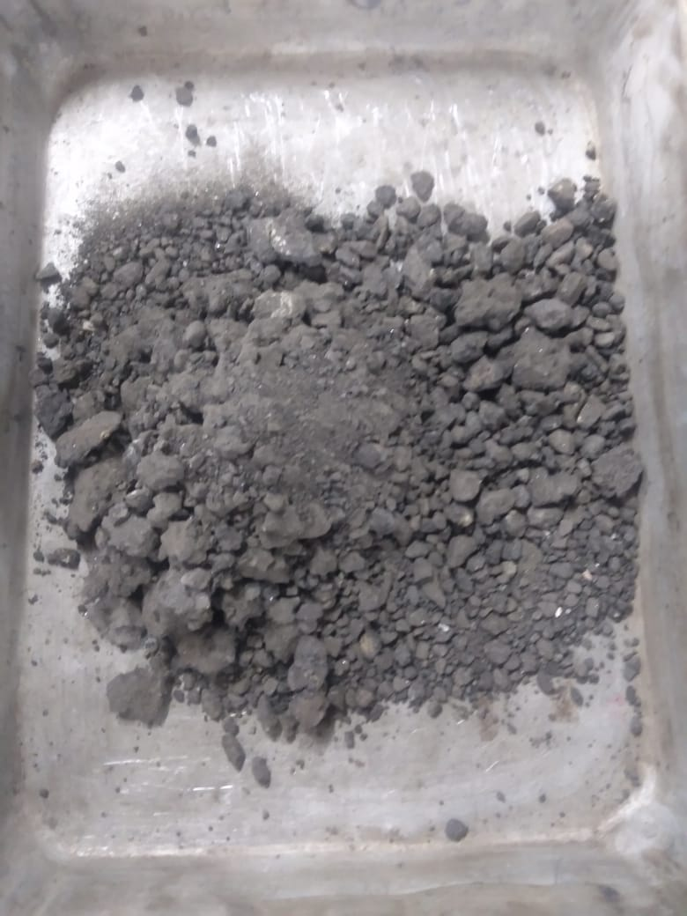
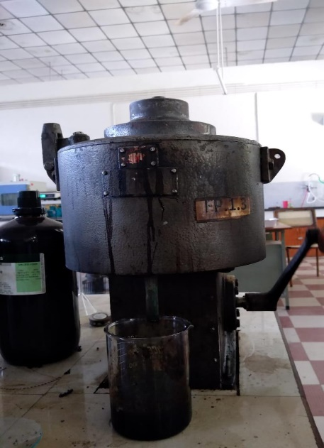
Fig 1: Asphalt Compactor
Fig 2: Specimens
Fig 3: Water bath
Fig 4: Marshall Apparatus
Fig 5: Marshall Shear Indicator
Fig 6: RAP
Fig 7: Bitumen extractor

Slide 14
MARSHALL GRAPHS
BINDER CONTENT V/S STABILITY
BINDER CONTENT V/S FLOW VALUE

Slide 15
BINDER CONTENT V/S UNIT WEIGHT
BINDER CONTENT V/S AIR VOIDS

Slide 16
BINDER CONTENT V/S VMA(PERCENT VOIDS IN MINERAL AGGREAGATES)
BINDER CONTENT V/S VFA(VOIDS FILLED WITH ASPHALT)

Slide 17
BINDER CONTENT V/S STABILITY
VOLUMETRIC PROPERTIES OF WMA WITH DIFFERENT QUANTITIES OF RAP
BINDER CONTENT V/S FLOW VALUE

Slide 18
BINDER CONTENT V/S UNIT WEIGHT
BINDER CONTENT V/S AIR VOIDS

Slide 19
BINDER CONTENT V/S VOIDS IN MINERAL AGGREGATE (VMA)
BINDER CONTENT V/S VOIDS FILLED WITH ASPHALT (VFA)

Slide 20
DISCUSSIONS
EFFECT ON BINDER CONTENT
20% and 40% RAP requires less binder than OBC
60% and 80% RAP requires more binder than OBC
Increase in VFA value for 20% and 40% RAP
Increase in RAP content resulted in the lack of melting of the binder.
EFFECT ON STIFFNESS AND FLOW
Stiffness of the mix increases with an increase in RAP content while the flow decreases.
Effect on stiffness and flow is due to the increase in RAP content.
Solution : Increase the effective dose of Zycotherm
Solution: Increasing the pre heating temperature of RAP
EFFECT ON VOIDS FILLED WITH ASPHALT
Due to presence of excess binder
Solution: Increasing the mixing temperature of RAP and effective dose of Zycotherm

Slide 21
COST COMPARISON ANALYSIS
HMA MIX |  |  |  |  | WMA-RAP MIX
Item | Unit | Unit price (Rs.) | Total Quantity | Cost (Rs) | Item | Unit | Unit Price (Rs.) | Total Quantity | Cost (Rs)
Coarse aggregate | cum | 900 | 0.304 | 273.60 | Coarse aggregate | cum | 900 | 0.122 | 109.44
Fine aggregate | cum | 1200 | 0.275 | 330.00 | Fine aggregate | cum | 1200 | 0.110 | 132.00
Bitumen | ton | 34600 | 0.058 | 2024.79 | Bitumen | ton | 34600 | 0.033 | 1142.15
 |  |  |  |  | Milling | hour | 10000 | 0.347 | 6.30
 |  |  |  |  | Zycotherm | kg | 2000 | 0.041 | 82.60
Total Cost |  |  |  | 2628.39 |  |  |  |  | 1472.49
For a sample of 1200 kg, the cost comparison analysis is mentioned in the above table.
The rates are taken from the MoRTH and the Delhi Schedule of Rates specifications.

Slide 22
CONCLUSION
Use of HMA led to environmental effects.
WMA reduced environmental effects but was inefficient
Sustainable development by WMA-RAP technology
Binder content for 20% and 40% RAP was less than OBC while 60% and 80% RAP required more binder content
Optimum RAP content – 60%
Analysis of effect on volumetric properties
Cost comparison

Slide 23
SCOPE FOR FURTHER WORK
Optimize the effective dose of Zycotherm
Optimize the pre heating temperature of RAP
Aging studies on RAP
Performance study of mix with optimum RAP on field

Slide 24
REFERENCE
Guo, M., Liu, H., Jiao, Y., Mo, L., Tan, Y., Wang, D., Liang, M. (2020). “Effect of WMA-RAP technology on pavement performance of asphalt mixture: A state-of-the-art review”, Journal of Cleaner Production, Science direct volume 266
Hettiarachchi, C., Hou, X., Wang, J., Xiao, F. (2019). “A comprehensive review on the utilization of reclaimed asphalt material with warm mix asphalt technology”, Construction and Building Materials, Science direct volume 227
Ayazi, M. J., Moniri, A., Barghabany, P. (2017). “Moisture susceptibility of warm mixed- reclaimed asphalt pavement containing Sasobit and Zycotherm additives”, Petroleum Science and Technology.
Alsalihi M., Faheem A. (Compaction and Performance of Warm-Mix Asphalt with High-Reclaimed Asphalt Pavement J. Mater. Civ. Eng. ASCE (2020)
Rubio, M. C., Martínez, G., Baena, L., Moreno, F. (2012). “Warm mix asphalt: an overview” Journal of Cleaner Production, Science direct volume 24, pp 76-84
MS-2 Asphalt Mix Design Methods, Chapters 1-7
Ministry of Road Transport and Highway (MoRTH) – Specifications for Road and Bridge Works
Indian Standards – IS 2386 (Part 4)- 1963, IS 73: 2013

Slide 25
THANK YOU

